Slide 1


HACK WITH IIC
AN ALTERNATIVE LEARNING ENVIRONMENT FOR STUDENTS
By-
SIDDHARTH MOHANTY
SUDHANSU PANIGRAHI

Slide 2

CONTENTS:
INTRODUCTION
IMPACT ON GLOBAL EDUCATION
PURPOSE OF THE PROJECT
FEATURES
CONCLUSION

Slide 3

INTRODUCTION:
.COVID-19 IS AN ONGOING PANDEMIC THAT HAS SPREAD TO 200+ COUNTRIES WIPING OUT GREATER THAN 55700 LIVES TILL DATE.
IT HAS LED TO SEVERE SOCIO-ECONOMIC DISRUPTIONS,THE POSTPONEMENT OR CANCELMENT OF MANY SPORTING, RELIGIOUS,CULTURAL EVENTS AND WIDESPREAD FEARS OF SUPPLY SHORTAGES RESULTING IN PANIC BUYING
SCHOOLS AND UNIVERSITIES HAVE CLOSED IN MORE THAN 160 COUNTRIES AFFECTING MORE THAN 1.5 BILLION STUDENTS

Slide 4

IMPACT ON GLOBAL EDUCATION:
AS OF 28TH MARCH 2020 , OVER 1.7 BILLION LEARNERS WERE OUT OF SCHOOL DUE TO SCHOOL CLOSURES IN RESPONSE TO THE COVID-19 .
ACCORDING TO THE UNESCO MONITORING REPORTS,OVER 100 COUNTRIES HAVE IMPLEMENTED NATIONWIDE CLOSURES , IMPACTING NEARLY 90% OF WORLD’S STUDENT POPULATION
UNESCO HAS RECOMMENDED THE USE OF DISTANCE LEARNING PROGRAMS,,OPEN LEARNING APPLICATIONS AND PLATFORMS THAT SCHOOLS AND TEACHERS CAN USE TO REACH LEARNERS REMOTELY AND LIMIT THE DISRUPTION OF EDUCATION

Slide 5

PURPOSE OF THE PROJECT:
IN RESPONSE TO THE EDUCATIONAL IMPACT OF COVID-19 PANDEMIC, THE PURPOSE OF THE PROJECT IS TO DEVELOP AN ALTERNATIVE LEARNING ENVIRONMENT FOR STUDENTS.
OUR AIM IS TO DEVELOP A WEBSITE WHICH WOULD ALLOW STUDENTS WORLDWIDE TO COMPLETE THEIR COURSES VIA INTERACTIVE SESSIONS WITH THEIR TEACHERS IN TIME IN ANY EDUCATION LEVEL THEY ARE IN , RANGING FROM PRIMARY TO POST GRADUATION LEVELS.
TEACHERS WILL BE ALLOWED TO POST THE VIDEO SESSIONS SO THAT THE STUDENTS CAN WATCH IT LATER ACCORDING TO THEIR CONVENIENT TIME
THE STUDENTS WILL BE GETTING THE OPTION TO LEARN EXTRA COURSES APART FROM TEXTUAL LEARNING SO THAT THE DEVELOP SKILLS AND PRACTICALLY APPLY THEM IN THEIR DAY TO DAY LIFE.
THE TEACHERS WOULD ALSO BE ABLE TO DEVELOP SKILLS ACCORDING TO THEIR NEEDS.
WE COULD HELP OPEN UP DISCUSSION FORUMS WHERE STUDENTS CAN INTERACT WITH SENIORS OR OTHER LIKE MINDED STUDENTS ON VARIOUS TOPICS.
IN ADDITION TO THAT THIS PLATFORM WOULD ALLOW STUDENTS TO TAKE INITIATIVE AND OPEN UP THEIR PLETHORA OF KNOWLEDGE. THEY CAN CONDUCT LIVE SESSIONS OR RECORDED SESSIONS TO TEACH VARIOUS IMPORTANT TOPICS LIKE ML,AI,CODING ETC SO THAT SKILLS ARE DEVELOPED SIMULTANEOUSLY.

Slide 6
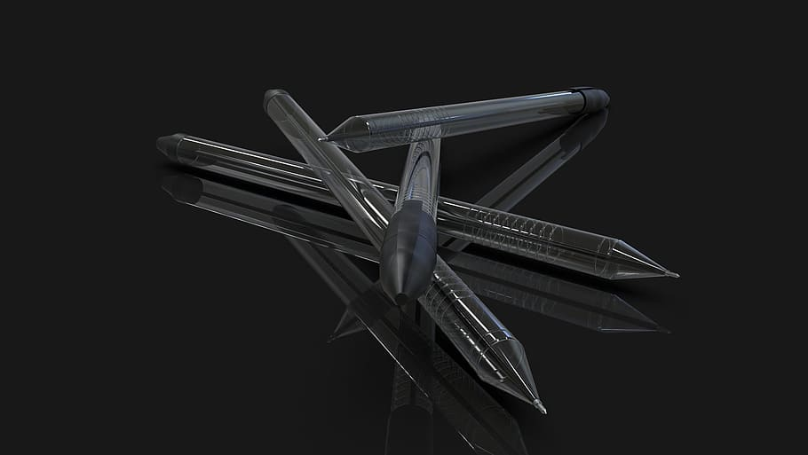
FEATUTRES OF THE WEBSITE
THE WEBSITE HAS A CONSIDERABLE NUMBER OF FEATURES.
THE SLIDES STARTING BELOW ARE THE PROTOTYPES OF THE WEBSITE AND ITS OPTIONS FOLLOWED BY THE EXPLATIONS TO EACH FEATURE.
THE SLIDES BELOW ARE THE HOME PAGE OF THE WEBSITE(PROTOTYPE) DIVIDED INTO 5 DIFFERENT SCREEN CAPTURES FOR BETTER UNDERSTANDING AND EXPLANATION.

Slide 7
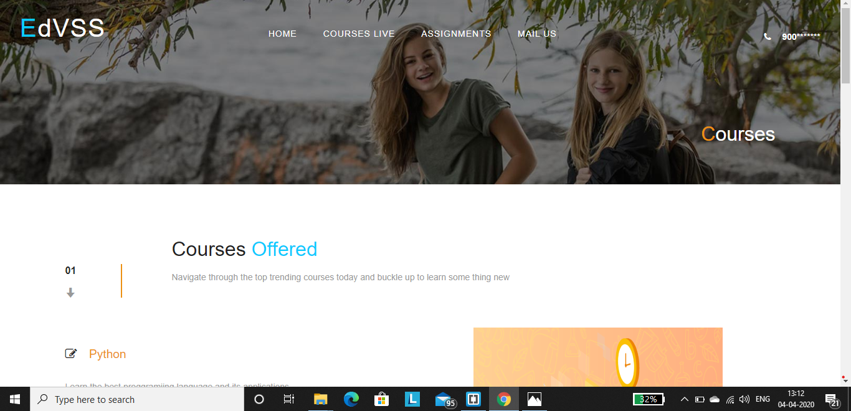

Slide 8
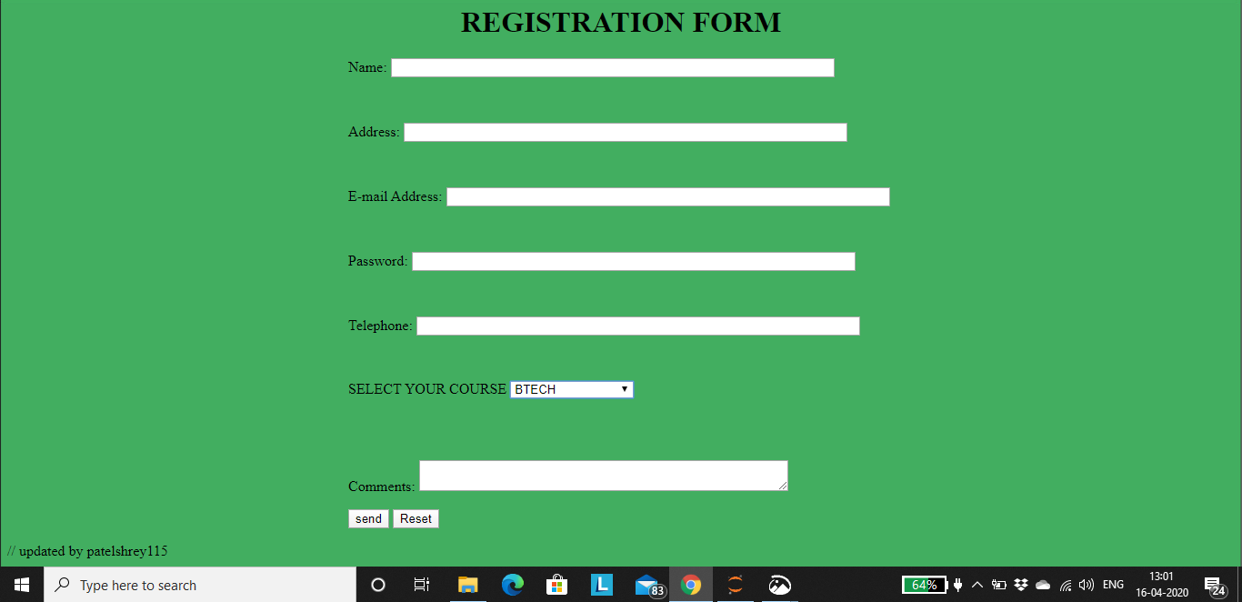

Slide 9

EXPLANATION TO FEATURES OF ABOVE SLIDE :
COURSES LIVE: THIS WOULD ALLOW STUDENTS TO ACCESS THE ON GOING LECTURES OR DISCUSSION FORUMS CATEGORICALLY.
ASSIGNMENTS: THIS WOULD CONTAIN ALL TASKS HANDED OUT BY THE RESPECTIVE SUBJECT TEACHERS OR COURSE MENTORS TO BE COMPLETED IN THE GIVEN TIME SLOTS.
COURSES : THIS WOULD HELP THOSE WHO MISSED OUT ON DISCUSSION FORUMS TO SEE RECORDED VIDEOS OR TO EXTRACT VIDEOS OF THEIR RESPECTIVE LECTURERES.
MAIL US : ITS USED IN CASE OF GRIEVANCES OR TECHNICAL GLITCHES.

Slide 10
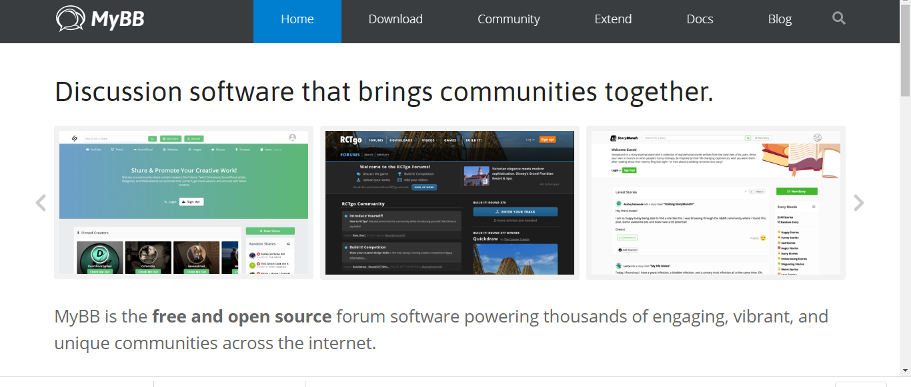

Slide 11
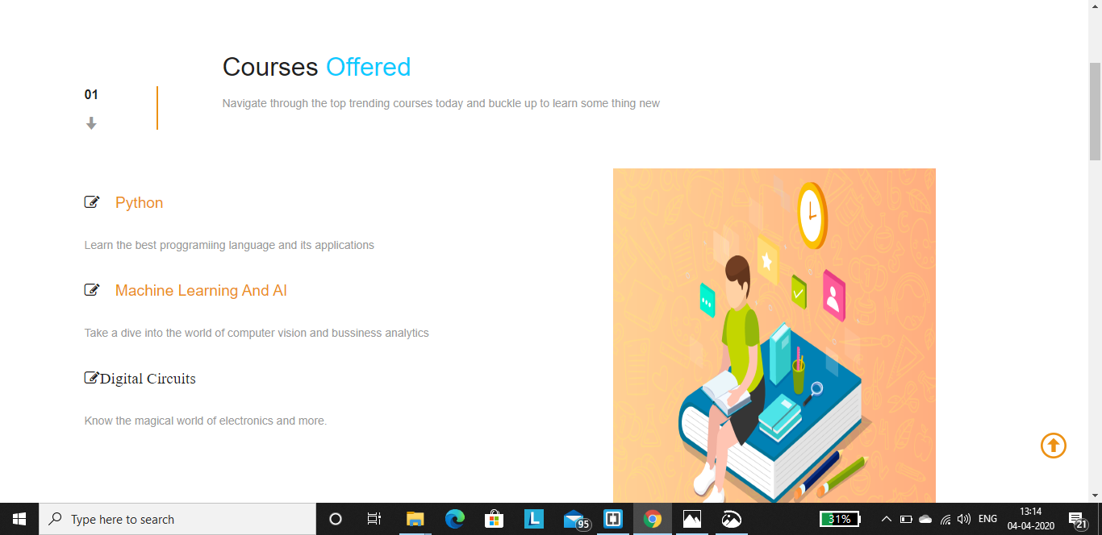

Slide 12

EXPLANATION TO THE ABOVE SLIDE :
THIS SLIDE BASICALLY CONTAINS THE TOP SORT AFTER OR TRENDING COURSES WHICH WE COULD ADD TO MAKE IT LOOK MORE INTRESTING AND GIVING A GET GO TO THOSE WHO ARE UNSURE ABOUT WHERE TO START BUILDING UP. THIS FEATURE IS SIMILAR TO TRENDING VIDEOS ON YOUTUBE.

Slide 13
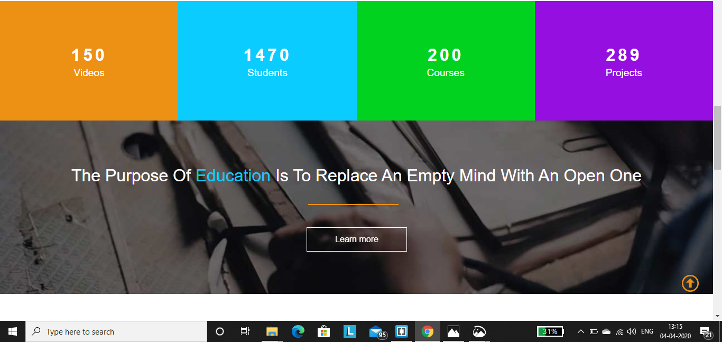

Slide 14
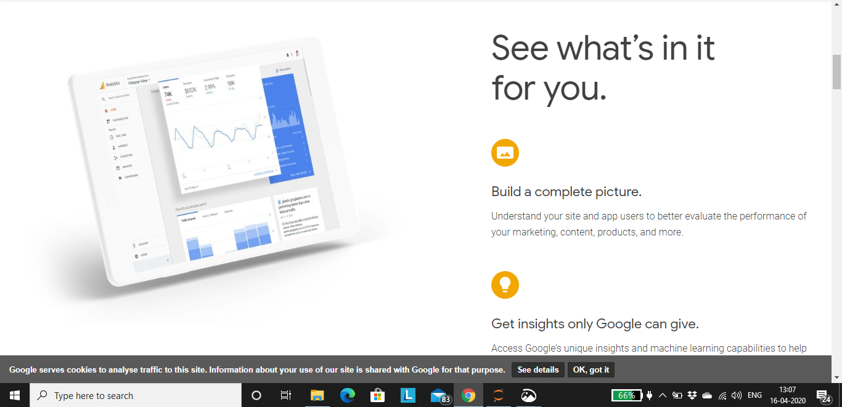

Slide 15

EXPLANATION TO THE ABOVE SLIDE:
THIS SLIDE BASICALLY CONTAINS DATA OF UPLOADED VIDEOS,STUDENTS ENROLLED ,COURSES AVAILAIBLE AND ONGOING PROJECTS. THIS COUNT WOULD ADD A GOOD BEAUTIFICATION TO THE WEBSITE AND INFORMATIONS.
ANOTHER IMPORTANT FEATURES IS PROJECTS.THIS WOULD ALLOW STUDENTS OF SIMILAR INTREST TO FORM UP AND TAKE UP PAPERS OR PROJECTS FOR RESEARCH OR WORK ON A COMMON GOAL.
ADDED TO THAT WE CAN ADD SOME MOTIVATIONAL QUOTES TO GIVE IT A FINENESS LIKE WE HAVE ADDED UP THERE.

Slide 16
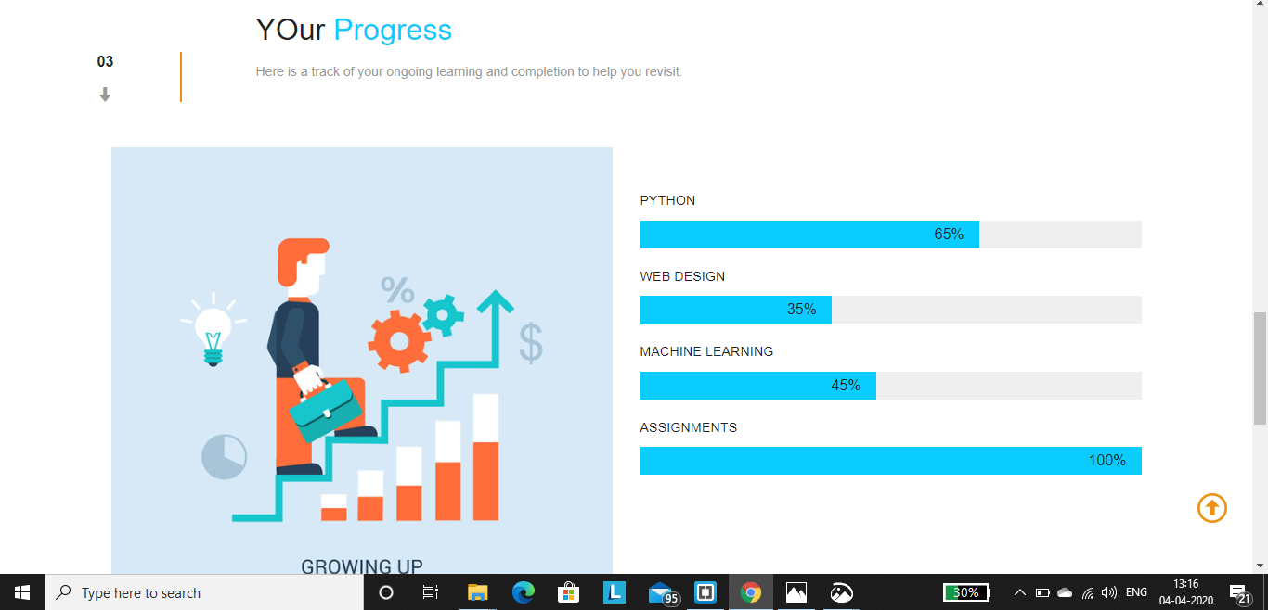

Slide 17
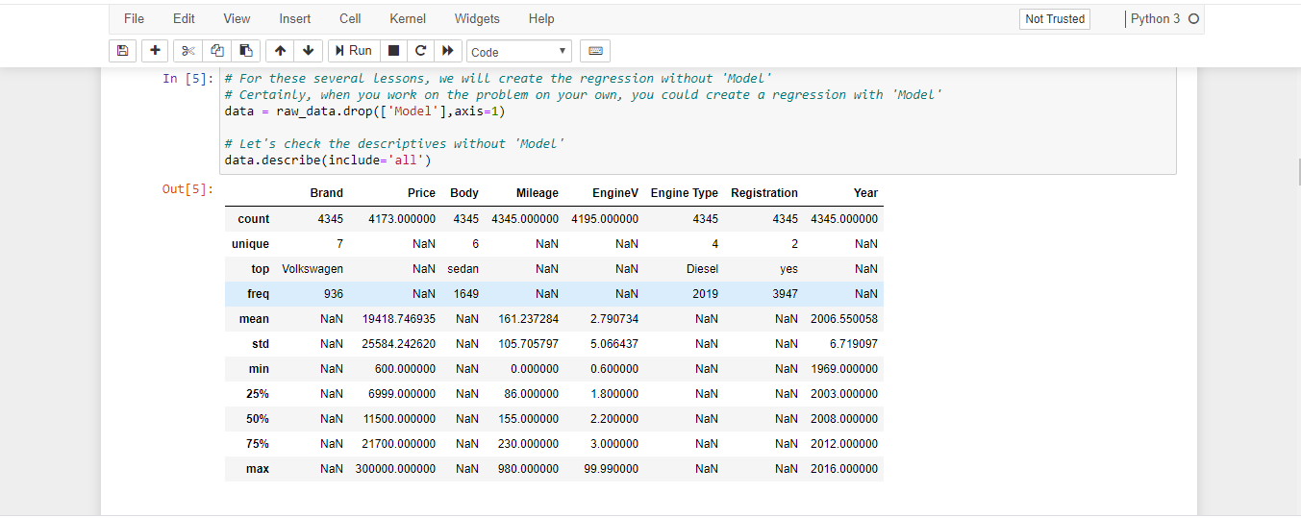

Slide 18
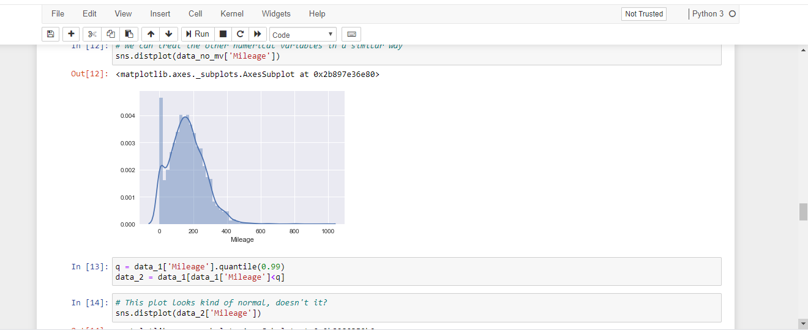

Slide 19

EXPLANATION TO THE ABOVE SLIDE :
THIS BASICALLY TRACKS THE STUDENTS PROGRESS IN TERMS OF HIS ACTIVITIES ON THE SITE.
THIS FEATURE WOULD HELP HIM/HER TO COMPARE HIS/HER PROGRESS AND COMPLETE IT WITHIN THE TIME FRAME.
THIS ALSO KEEPS TRACK OF THE DAILY ASSIGNMENT COMPLETION PROGRESSIS PART .

Slide 20
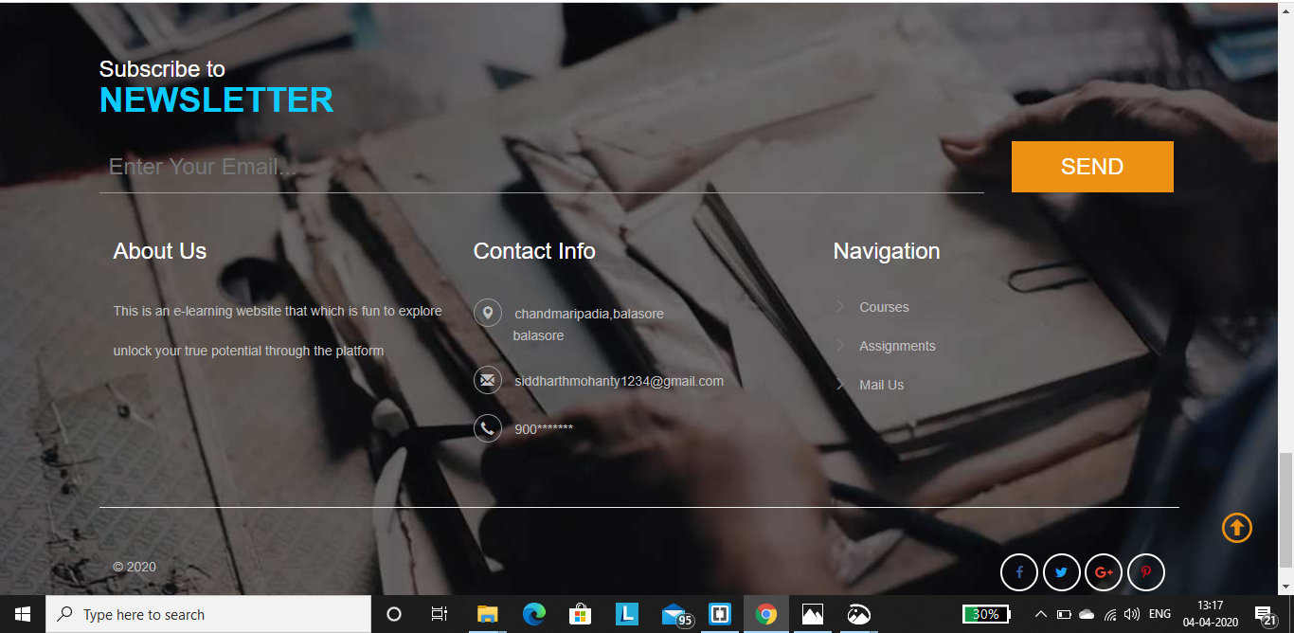

Slide 21
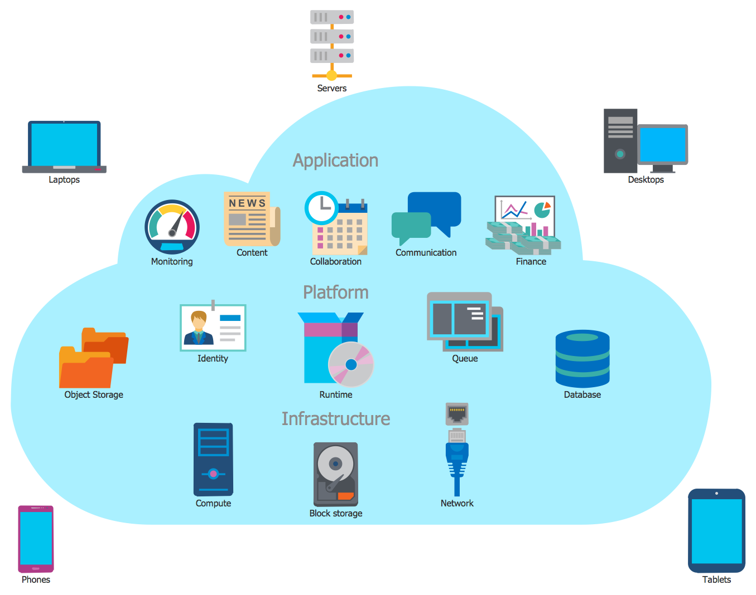

Slide 22

MANAGING THE DATABASE
WE COULD USE CLOUD BASED SERVERS FOR MANAGING OUR DATABASES BASED ON CATEGORIES OF THE STUDENTS WHICH INCLUDE THE BRANCH THEY HAIL FROM. BUT STILL IT WILL NOT BE SUFFICIENT FOR FOR THE AMOUNT OF VIDEOS AND DOCUMENTS UPLOADED.
SO FOR VIDEOS WE COULD DO ONE THING THAT UPLOAD VIDEOS ON GOOGLE DRIVE OR DROPBOX AND SEND THE LINK TO THE RESPECTIVE CATEGORIES.BUT STILL THAT WOULD NOT SOLVE OUR SPACE REQUIREMENTS. FOR THAT WE COULD USE YOUTUBE AND DO THE PROCEDURE AS ABOVE.
TO SORT THE LINKS INTO CATEGORIES WE COULD COME UP WITH A VALIDATION FORM ASKING DDETAILS ABOUT THE CATEGORY TO WHICH THIS VIDEO WOULD FIT INTO AND THE UPLOADER DETAILS.

Slide 23

EXPLANATION TO THE ABOVE SLIDE:
THIS IS JUST THE END OF THE PAGE WHERE YOU CAN FIND THE CONTACT INFORMATIONS AND SUBSCRIPTION TO NEWS LETTERS.
ADDED TO THAT WE CAN ADD OPTIONS TO SHARE THIS WEBSITE ON VARIOUS PLATFORMS LIKE FACEBBOK , TWITTER , PINTREST ETC.
THERE IS ALSO A NAVIGATION COLUMN TO HELP STUDENTS NAVIGATE TO THE TOP OR TO A PARTICULAR PAGE.

Slide 24

HOPE YOU LIKED OUR PRESENTATION AND THANK YOU FOR BEING PATIENT
SUBMITTED BY: TEAM D20

